Slide 1
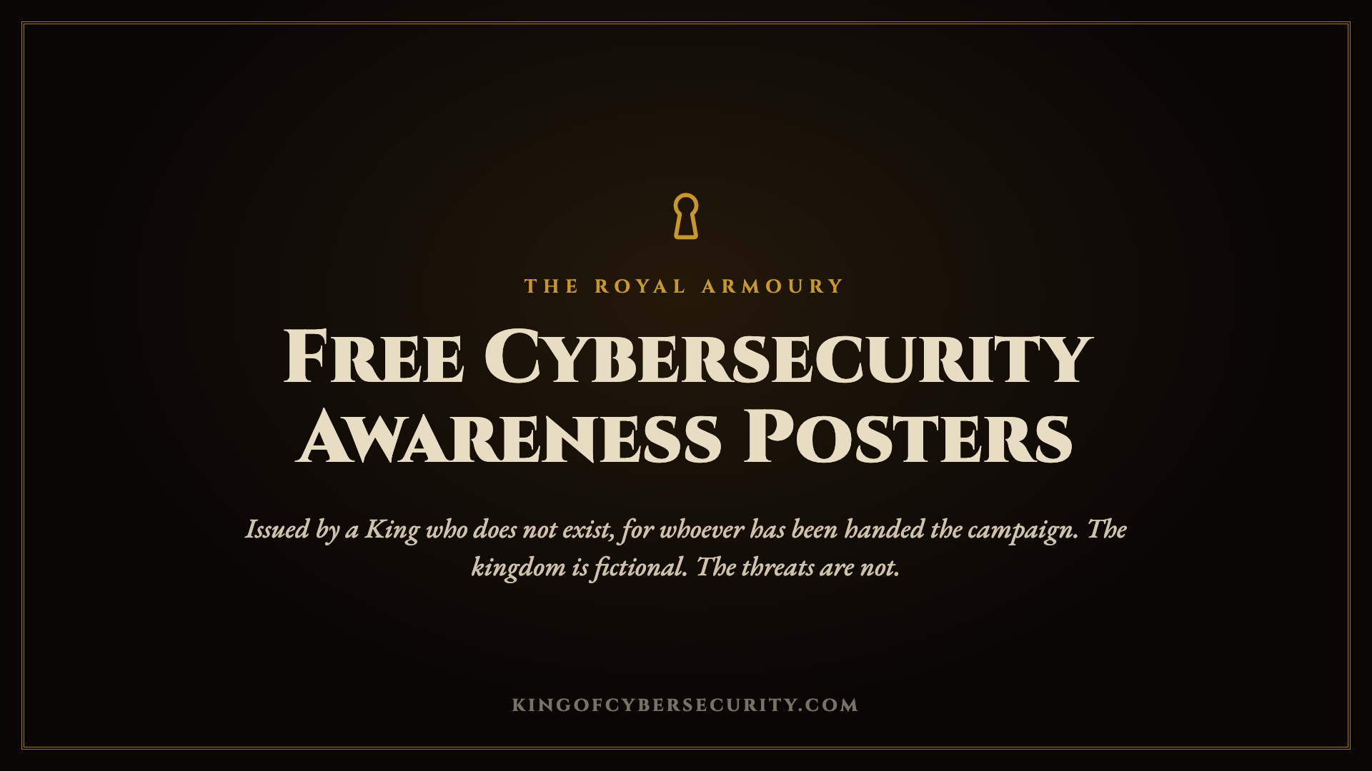
Notes:
Everything in this deck is free to use unaltered. The credit is already on each poster.
Speaker notes are on the three poster slides. They are written to be read aloud.

Slide 2
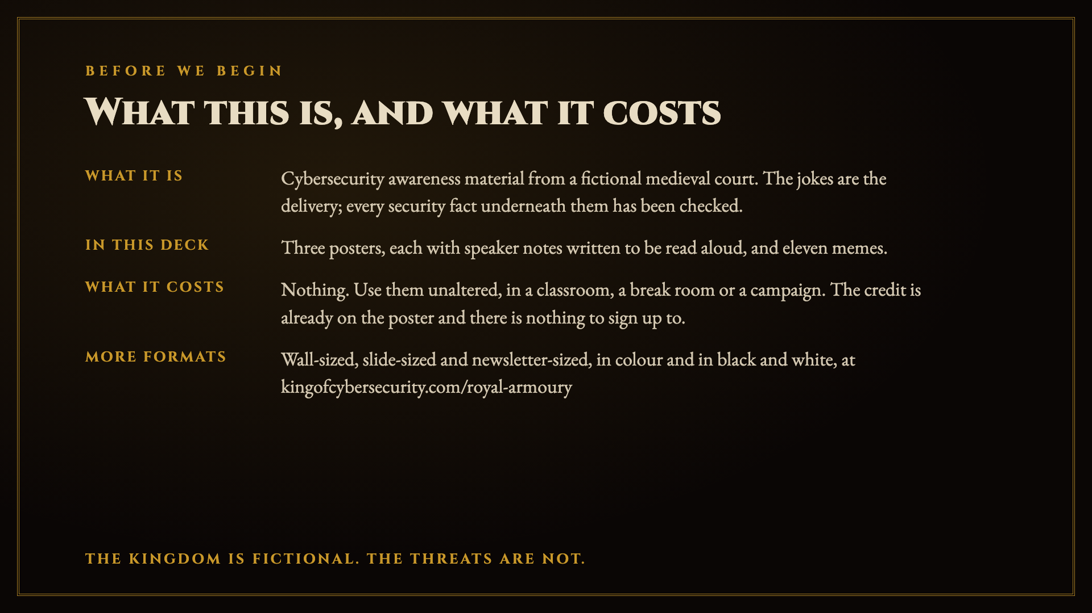
Notes:
Read the last line aloud if nothing else: the kingdom is fictional, the threats are not. Everything funny here is invented. Everything underneath it has been checked twice.

Slide 3
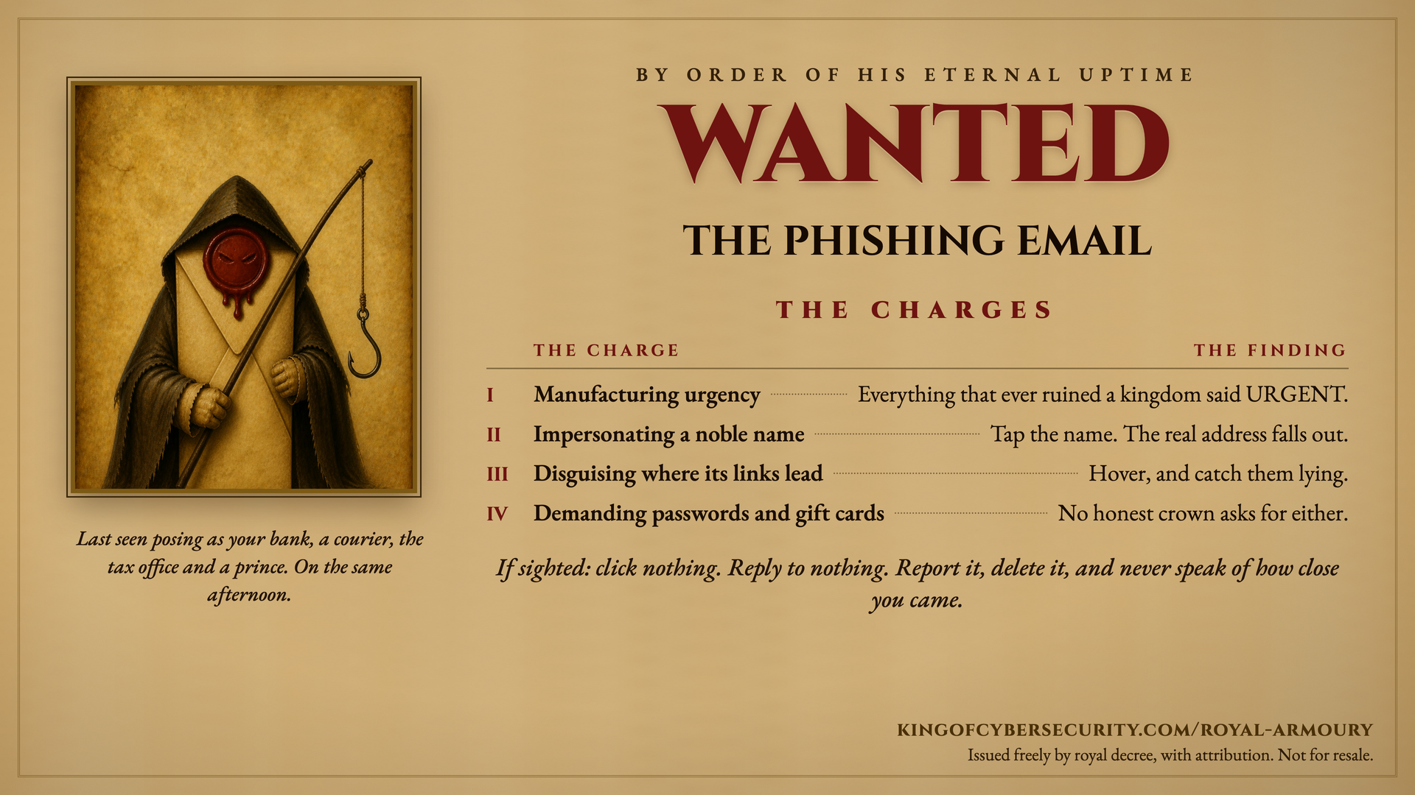
Notes:
Speaker notes, as supplied by the court.
The charges are real phishing indicators:
- Urgency: scammers manufacture deadlines because frightened people stop checking. Slowing down defeats the technique.
- Impersonating a noble name: tap or expand the sender's display name; the real address hides behind it.
- False links: hover on desktop, long-press on mobile, and preview the destination before clicking.
- Passwords and gift cards: no legitimate bank, tax office or helpdesk asks for either. The request itself is the tell.
If someone is caught by one: report it through your organisation's channel, delete it, change any password given away (everywhere it was reused) and enable two-factor authentication.
UK reporting: forward emails to report@phishing.gov.uk; forward scam texts to 7726.
This slide is issued free by kingofcybersecurity.com/royal-armoury, with attribution. Not for resale.

Slide 4
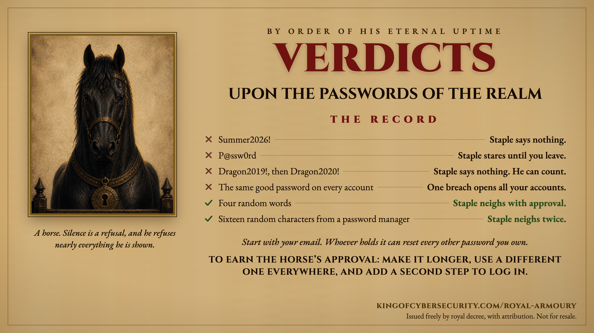
Notes:
Speaker notes, as supplied by the court. The record is a real one: every verdict encodes current password guidance (NIST SP 800-63B).
- Summer2026! passes a composition policy and fails reality. Predictable patterns are the first thing cracking tools try, and a capital plus a number plus a punctuation mark is the most predictable pattern there is.
- P@ssw0rd is "password" with substitutions, and every cracking dictionary already contains it. Character substitution buys nothing.
- Dragon2019! becoming Dragon2020! is not a new password. Note: this is not advice to stop rotating if your organisation requires it. It is advice that incrementing is not rotation.
- The same good password on every account is what makes credential stuffing work. When any one site is breached, the attacker tries that pair everywhere else. Reuse turns one company's bad day into yours.
- Four random words is a passphrase: length beats complexity, and a human can actually remember it. Right for the few passwords you must keep in your head, such as your device login and the password manager's own master password.
- Sixteen random characters from a password manager takes the top honour because it is the only answer that scales. It makes them long, makes them different for every account, and remembers them so you do not have to.
What to say when someone asks what to do first: get a password manager, turn on a second factor for email and banking before anything else, and stop reusing. Email first, because it is the account that resets all the others.
Second factor, in plain terms: something beyond the password, such as an app code or a security key. An app or a key beats an SMS code, but an SMS code beats nothing at all.
If someone confesses to reusing a password that has since been breached: change it on the important accounts first (email, then banking, then anything holding payment details), and turn on the second factor while you are in there. haveibeenpwned.com will tell them which breaches their address has appeared in.
Attribution: kingofcybersecurity.com/royal-armoury. Free to use in awareness programmes, presentations, classrooms and newsletters, with attribution. Not for resale.

Slide 5
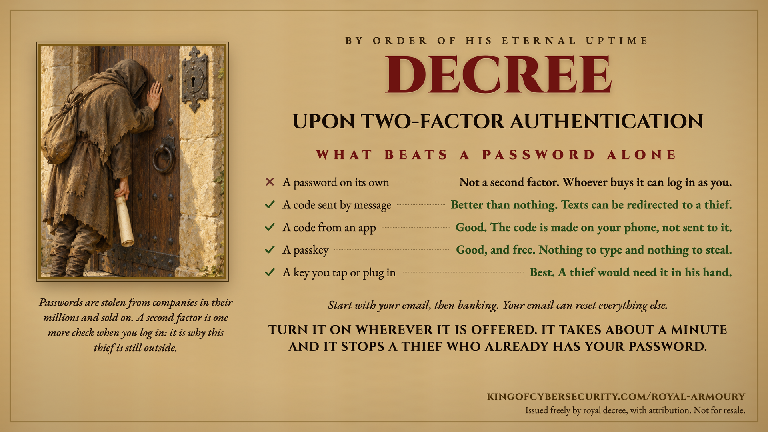
Notes:
Speaker notes, as supplied by the court. Every row on the record encodes current authentication guidance (NIST SP 800-63B, and the FIDO2/WebAuthn origin-binding property).
The one idea to land: the second factor is not there to keep your password secret. It is for after your password is already gone, which for most people it already is. The thief in the picture is not picking a lock. He has a working password and he is still outside.
- A password on its own is not a second factor at all. Credentials are stolen in bulk and traded as a commodity, so assume yours is out there rather than hoping it is not.
- A code sent by message is interceptable, by SIM swap and by attacks on the phone network, and NIST has restricted SMS as an out-of-band authenticator since 2017. Say the hedge out loud: this is far better than nothing, and nobody should switch SMS off because of this slide. It is the weakest of the working options, not a bad one, which is why the slide gives it a tick: the mark says it counts, and the ranking is carried by the words beside it.
- A code from an app is generated on the device from a shared secret and a clock, so it works with no signal at all: on a train, in a lift, abroad. Note what this row does not claim. An app code can still be typed into a convincing fake site.
- A passkey is the same credential the key below holds, kept on the phone, in a password manager or on a security key, and unlocked by a face or a PIN. There is no password to type and none to steal. Say plainly that it replaces the password rather than adding to it, which is why the row heading is what beats a password alone.
- A key you tap or plug in takes the top place for two reasons, and the first is the one a room understands: a thief would need it in his hand. It is also the only phishing-resistant option on the list. The credential is bound to the real site's address, so a lookalike cannot use it even if the person is completely fooled.
What to say when someone asks what to do first: turn it on for email before anything else, then banking, then anything holding payment details. Email first, because it is the account that resets all the others.
If someone says it will slow them down: enrolment is about a minute per account, and most services then stop asking on a device they already know. The cost is one minute; the alternative is that a correct password is the only thing between a stranger and the account.
If someone asks why the logs would not catch it: they would not, and that is the point of the closing line. A valid sign-in with a correct password does not look like an attack. The second factor stops it; the log only records it.
Attribution: kingofcybersecurity.com/royal-armoury. Free to use in awareness programmes, presentations, classrooms and newsletters, with attribution. Not for resale.

Slide 6
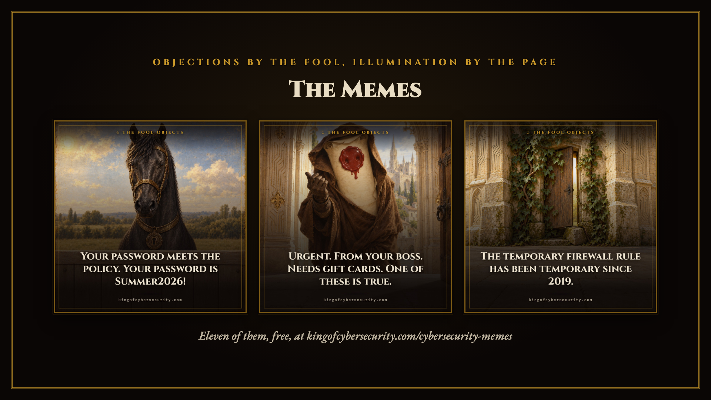
Notes:
Optional section. Cut everything after this slide if the room is short of time; the posters are the artefact and this one alone gives the flavour.
The three shown are a password, a phishing email and a firewall rule: three different topics rather than three versions of one joke.

Slide 7

Notes:
The temporary firewall rule has been temporary since 2019.
Opened for one afternoon by somebody in a hurry who has since left the company. The ticket is closed. The rule is not.

Slide 8
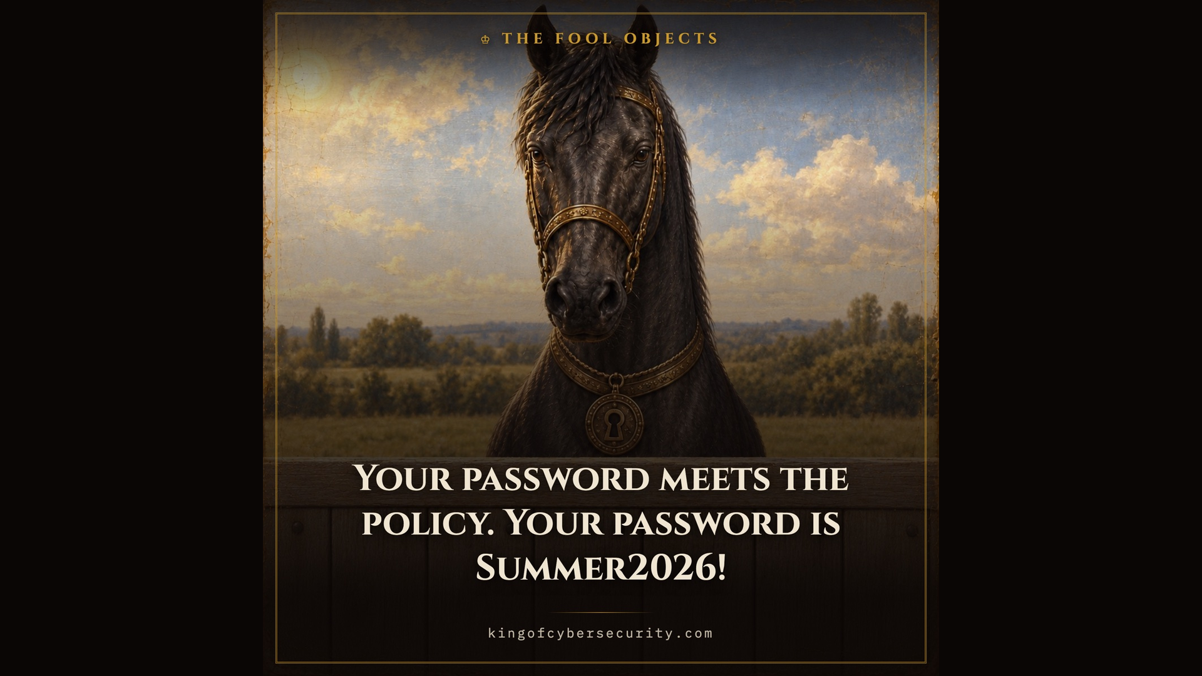
Notes:
Your password meets the policy. Your password is Summer2026!
It has a capital, a number and a punctuation mark, exactly where the policy said to put them. So does everybody else's.

Slide 9
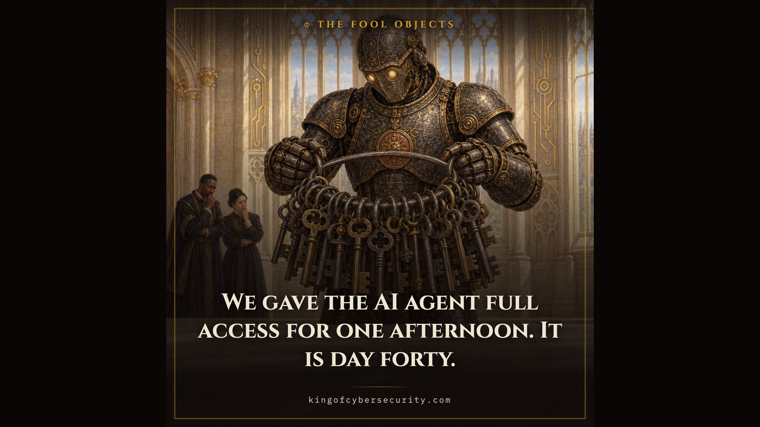
Notes:
We gave the AI agent full access for one afternoon. It is day forty.
Access granted for a trial is rarely taken back, because nobody wishes to be the one who slowed the machine down.

Slide 10
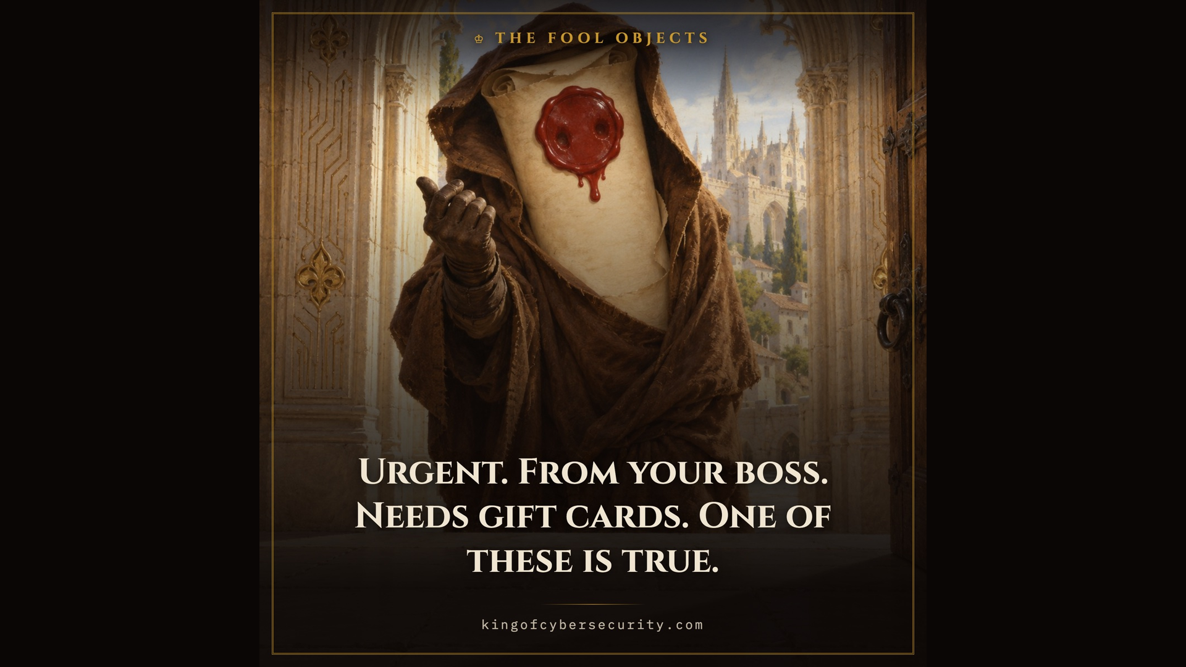
Notes:
Urgent. From your boss. Needs gift cards. One of these is true.
Urgency and authority both stop people checking, which is why the request that cannot possibly wait is the one that can.

Slide 11
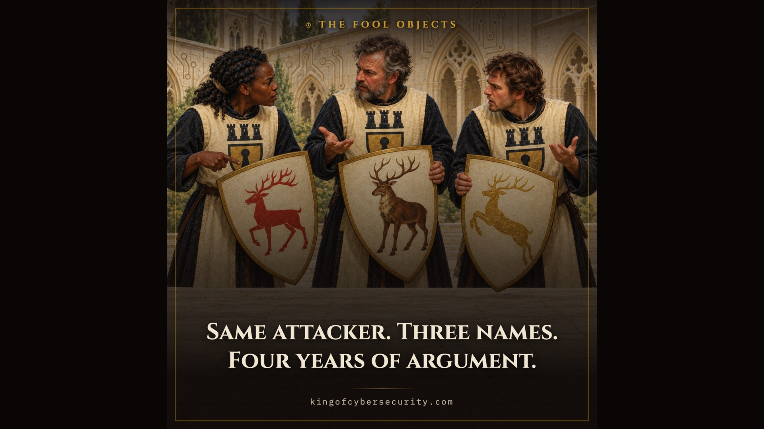
Notes:
Same attacker. Three names. Four years of argument.
Every firm names what it finds, none can overrule another, and the intruder is the only party present who is not confused.

Slide 12
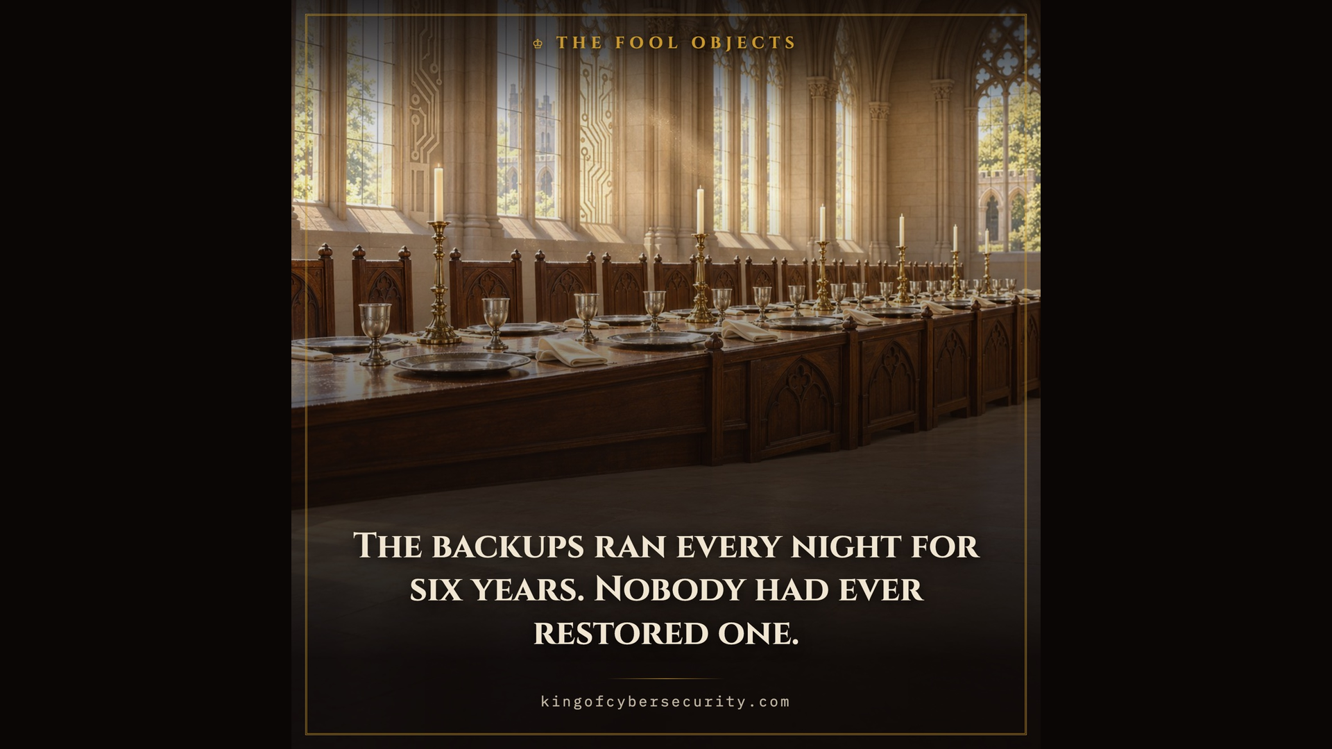
Notes:
The backups ran every night for six years. Nobody had ever restored one.
Every night, faithfully, for six years. The restore was tested once, in principle, at a meeting.

Slide 13
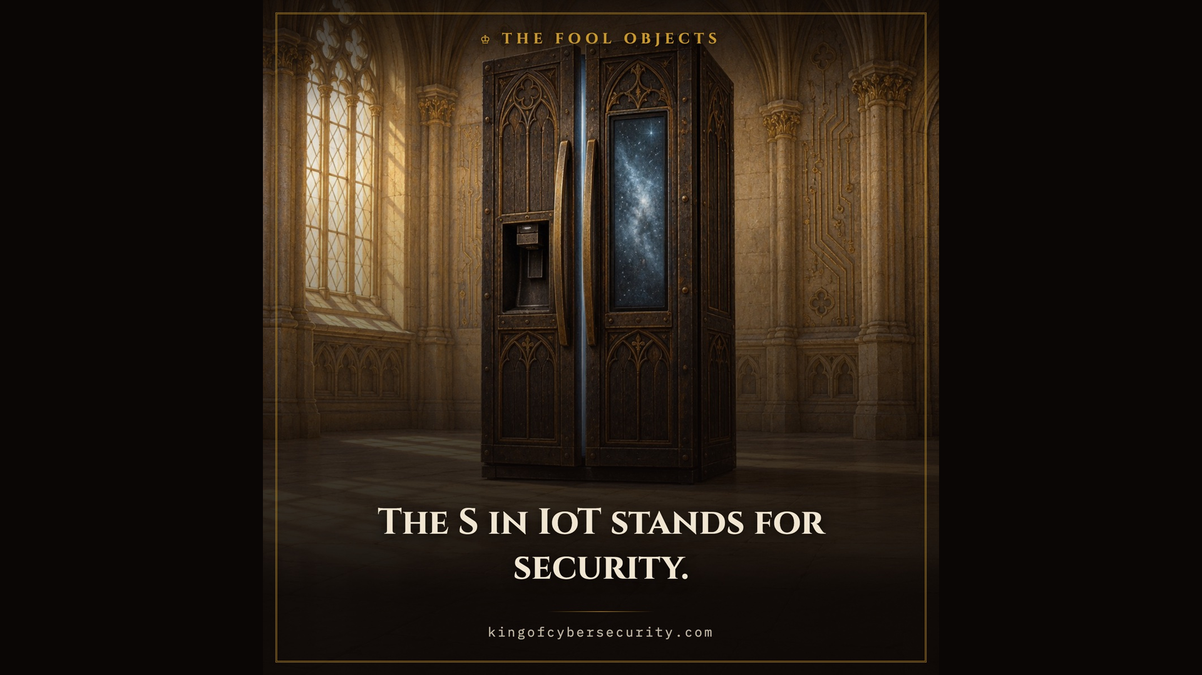
Notes:
The S in IoT stands for security.
There is no S in IoT. That is the joke and it is also the summary: sold on the strength of an app, shipped with a default password, supported until the manufacturer loses interest, and sitting on the same home network as everything else you own.

Slide 14
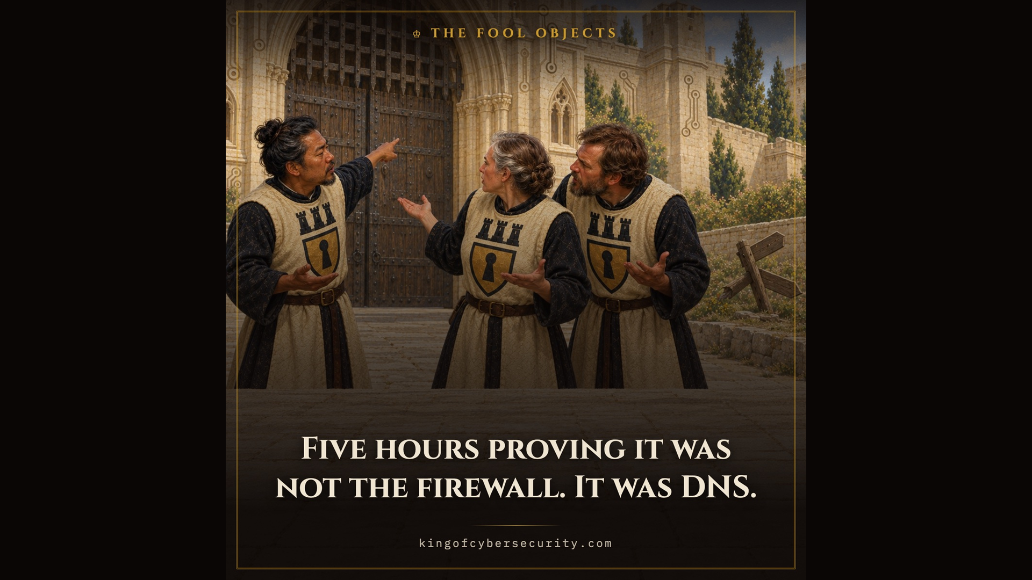
Notes:
Five hours proving it was not the firewall. It was DNS.
Why it is always DNS: it turns names into addresses, it is touched by everyone and owned by nobody, and it is the first thing worth checking and the last thing anyone checks. The firewall gets blamed first because it is the one with a name.

Slide 15
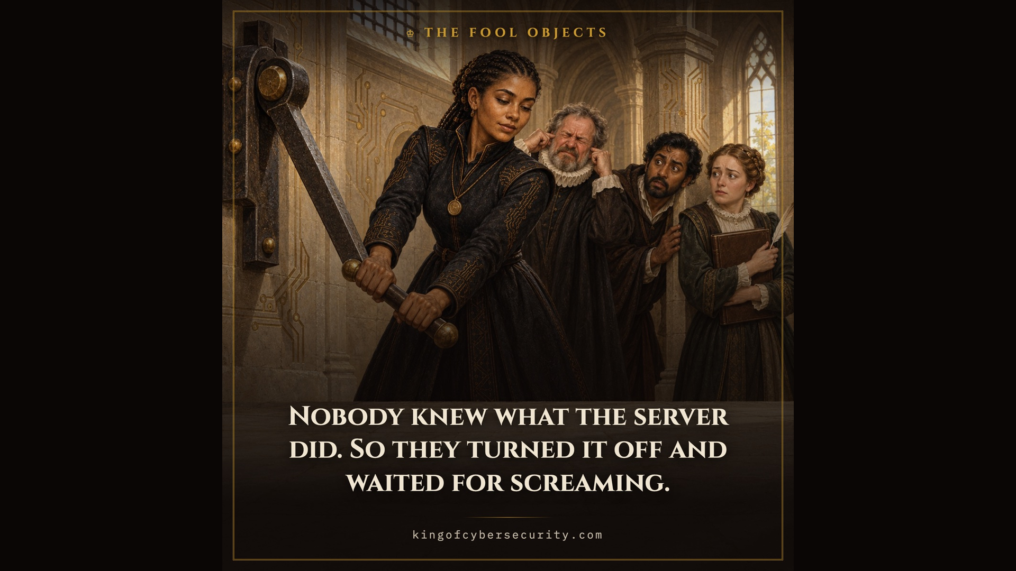
Notes:
Nobody knew what the server did. So they turned it off and waited for screaming.
This is a scream test, and it works, which is the problem. It is what you are left with when nothing was written down and the one person who knew has since left. Needing it is the finding, not the method.

Slide 16
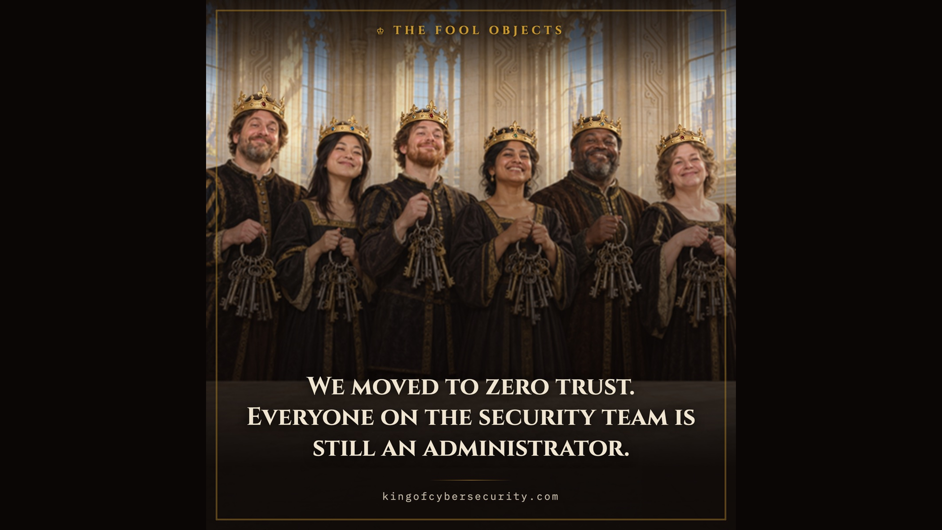
Notes:
We moved to zero trust. Everyone on the security team is still an administrator.
Zero trust is an architecture, not a purchase, and least privilege is most of it. It is also the one control that is always somebody else's turn to give up, so the keyring never gets smaller on its own.

Slide 17
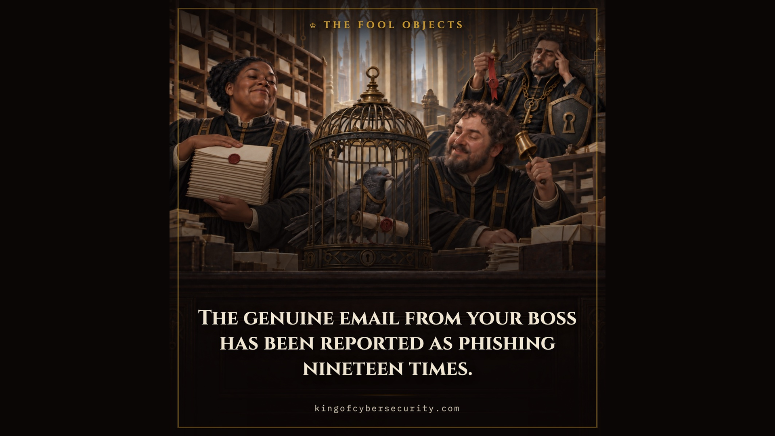
Notes:
The genuine email from your boss has been reported as phishing nineteen times.
Train people hard enough to report phishing and they will report everything, including the things you needed them to read. The court counts this as a success.

Slide 18
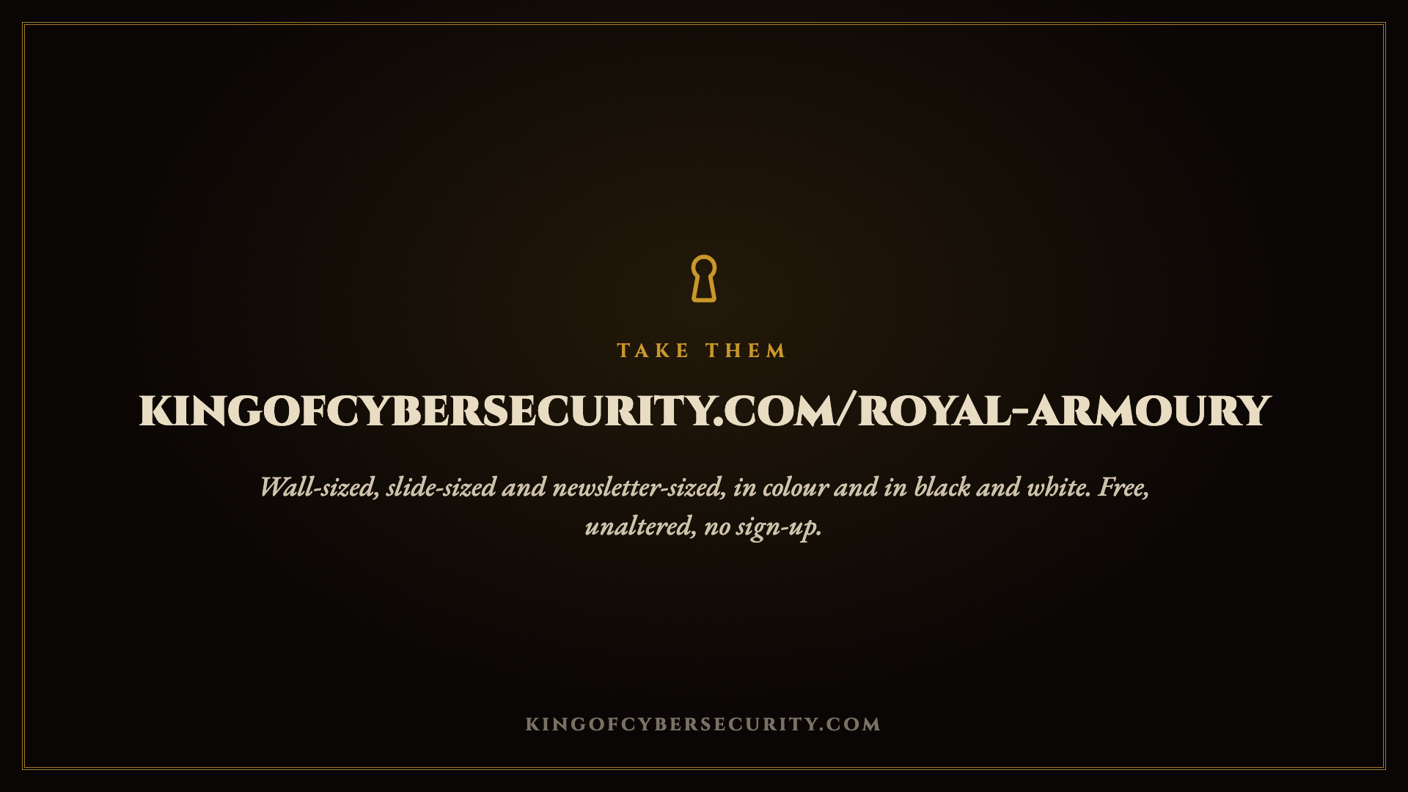
Notes:
The Armoury holds every format of every poster. Nothing on the site costs anything.

